Slide 1

WHO Core Indicators of
Age-friendliness
Megumi Kano, DR.P.H.
Technical Officer
WHO Centre for Health Development
Kobe, Japan
Notes:
In this webinar, I will be introducing you to the WHO core indicators of Age-friendliness. By the end, you can expect to know what the core indicators are, how they were developed, whether any communities have used them and what they’ve found, and also, how these core indicators can be helpful to you.

Slide 2

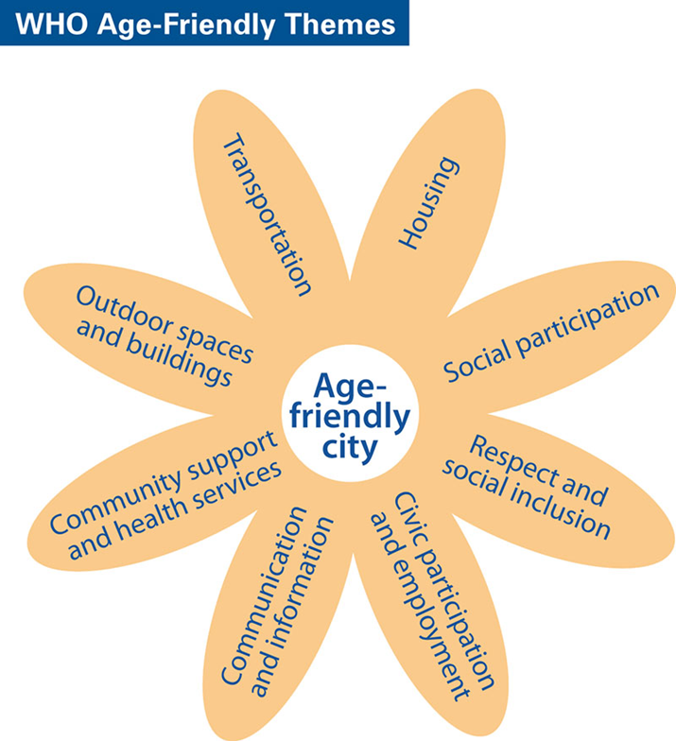
Concept of Age-friendly City
Domains of an Age-friendly City
An Age-friendly City is an inclusive and accessible community environment that optimizes opportunities for health, participation and security for all people in order that quality of life and dignity are ensured as people age.
Notes:
I’ll begin by providing a little bit of background on the WHO Age-friendly City and Community initiative. As you may know, WHO published a guide on Age-friendly Cities in 2007. The definition at the time was [see slide]. With the new public health framework of healthy ageing, presented in the WHO World Report on Ageing and Health in 2015, we might add an additional emphasis on optimizing people’s functional ability.
The original guide was developed based on qualitative research in over 30 cities around the world and it identifies 8 domains of urban policy which are essential to making cities more age-friendly.

Slide 3
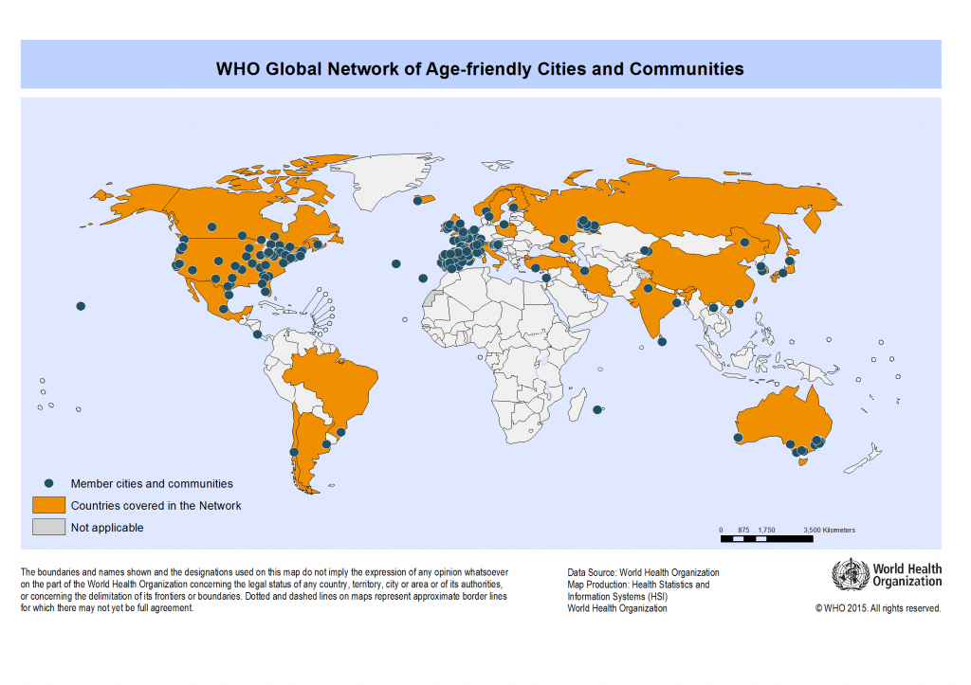
WHO Global Network of Age-friendly Cities and Communities
400 member cities in 37 countries covering over 146 million people worldwide
Notes:
In 2010, WHO launched the Global Network of Age-friendly Cities and Communities to foster exchange of knowledge and experience between Age-friendly Cities worldwide and to be inclusive of all communities, urban or not. As of today, the Global Network has 400 member cities in 37 countries covering over 146 million people worldwide.

Slide 4
Network members commit to a cycle of continuous improvement
Mechanism for involving older people
Baseline assessment
City-wide action plan
Indicators to monitor progress
Notes:
Members of the Global Network are asked to commit to a cycle of continuous improvement which includes a baseline assessment and the use of indicators to monitor progress. Ideally, the indicators should be carefully selected before the baseline assessment is conducted so that the same indicators can be tracked over time. At the same time, the baseline assessment can inform which indicators are better than others and should be included in a core indicator set.

Slide 5
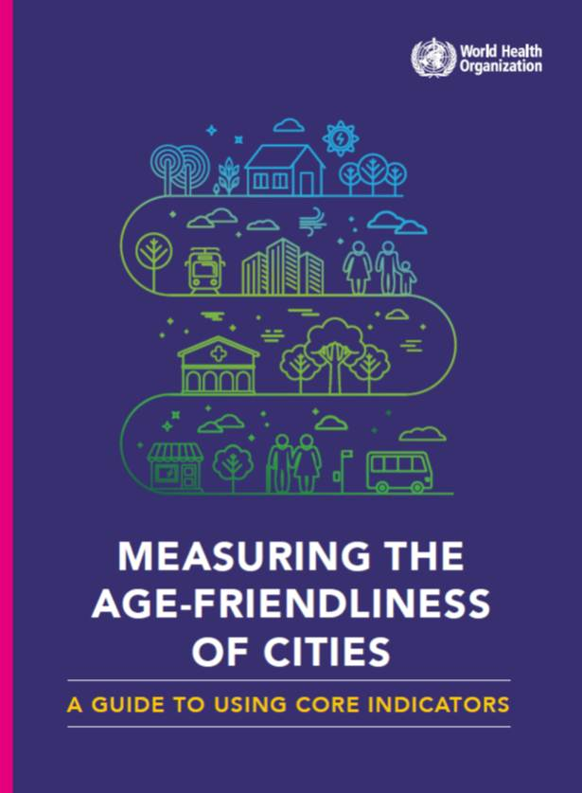
WHO Age-friendly City core indicator guide
Identifies a framework for selecting local indicator set
Defines core indicators
  Physical environment
  Social environment
  Impact
  Equity
Examples from pilot sites
Published in 2015
Available at: http://www.who.int/kobe_centre/publications/AFC_guide/en/
Notes:
In order to support network members in this process, as well as to offer a resource to other interested communities, WHO developed guidance on using core indicators to measure the age-friendliness of cities. The guide was published in 2015 and it describes a framework for selecting a local indicator set, as well as a set of core indicators which cover the domains of physical environment, social environment, impact and equity. I’ll explain the core indicators in more detail later.

Slide 6
Indicators are very useful!
Establishing a common understanding about a (new) concept
Setting goals and targets
Monitoring change over time as relevant interventions are implemented
Fostering political and social commitment and accountability
Benchmarking
Notes:
Why are indicators needed anyway? Indicators are succinct measures which describe a complex phenomenon. A few good indicators should be able to provide a fairly comprehensive picture without unnecessary detail. They are helpful for establishing a common understanding about a concept which could have multiple interpretations; they are useful for setting goals and targets, monitoring change over time, fostering accountability and benchmarking. Therefore, indicators are often a key component of evaluation, and while qualitative assessments of indicators can also be used, it’s most common to have quantifiable indicators.

Slide 7
Various uses of evaluation/indicators
Measure achievement of goals and targets
Enable benchmarking/comparisons
Inform policy development
Inform programme planning and management
Advance scientific knowledge/research
Raise awareness about a problem
At community or initiative level?
At global, national, or local levels?
Notes:
There are many possible purposes for evaluation. It might be to measure achievement, or to enable benchmarking. The purpose then influences the evaluation approach and the indicators to be measured. If the purpose is to advance scientific knowledge, it would be important to measure factors that can explain what makes a community age-friendly, as well as the causal effects of age-friendliness on health and wellbeing outcomes. Whereas if the objective is to inform programme planning and management, it would be important to monitor things like the use of resources and the population reach or coverage of interventions.

Slide 8
Main purposes of AFC core indicators
Enable benchmarking/comparisons at global, national and community levels
Inform policy development at global, national and community levels
Inform programme planning and management at local/community level
Advance scientific knowledge/research
Some degree of standardization and comparability but with flexibility to allow local adaptation.
Notes:
In the case of the WHO AFC core indicators, there was a dual focus. On one hand we want to enable benchmarking and comparisons, while on the other hand we wanted to make it useful for local policy and programme development. A secondary priority was to advance research in this field. As a result, we aimed to establish some degree of standardization and comparability of the indicators, while also ensuring flexibility of the indicators to allow local adaptation.

Slide 9
Process or Outcome evaluation?
Outcome-oriented: Target-setting, benchmarking, measuring achievements
Process-oriented: Monitoring progress, ensuring fidelity of program implementation, tracking resource use
Notes:
Another issue is whether the focus of the evaluation is on process or outcome. Ideally, you want to capture both. But what’s important is to make the distinction clear between the two, the means and the end. Outcome-oriented evaluation would focus on goals/targets and benchmarking, whereas process-oriented evaluation would focus more on monitoring progress and process, ensuring fidelity of implementation and such.

Slide 10
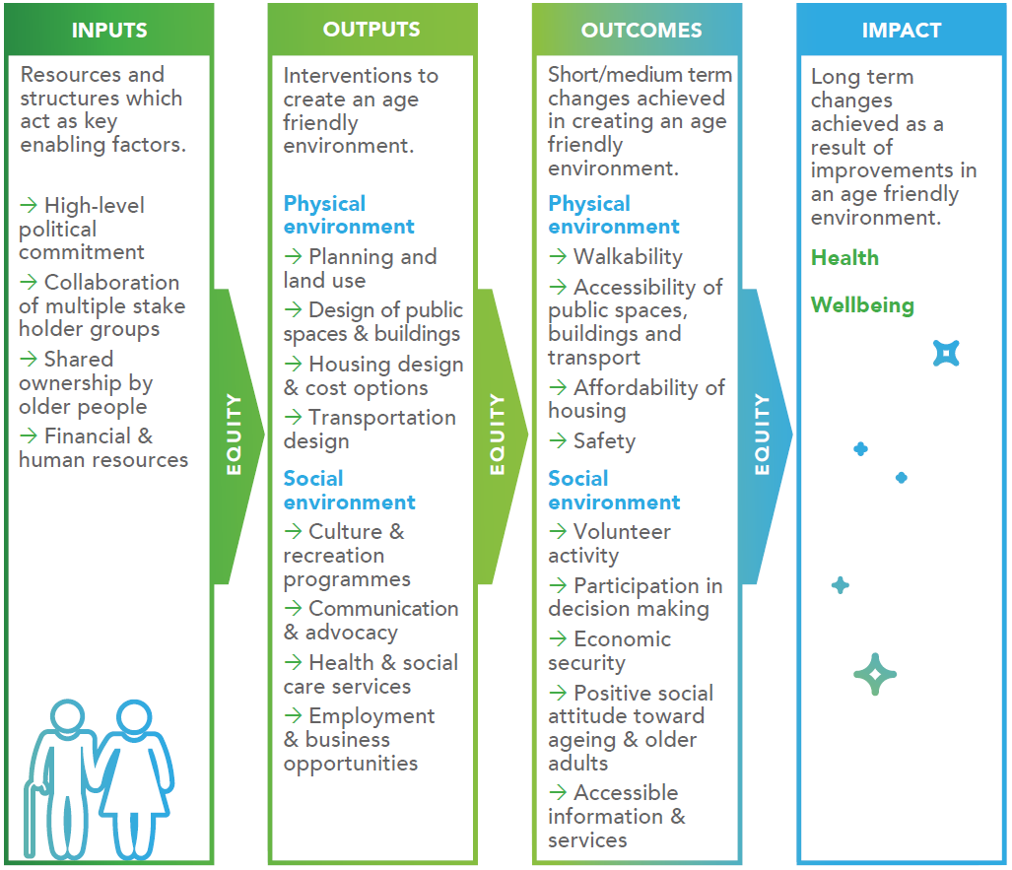

Framework for selecting local AFC indicator set
Notes:
The AFC core indicator guide presents a framework for the selection of a local set of age-friendly city indicators. It is based on a conventional logic model that connects inputs to outputs to outcomes to impact because it is widely known and accepted. This serves as a framework for identifying core indicators that you could potentially measure depending on your objective. In the case of the AFC core indicators, we recognized that the inputs and the outputs, in other words the actual interventions may vary across contexts, but the outcomes they are trying to achieve in terms of creating an age-friendly environment and impacting wellbeing are more or less similar, so we focused the indicators on these outcomes and impact.
Remember, these are guidelines aimed at the global level, so to some extent we had to focus on the largest common denominators. But for a localized indicator set, it would be appropriate to include those that capture inputs and outputs as well.

Slide 11
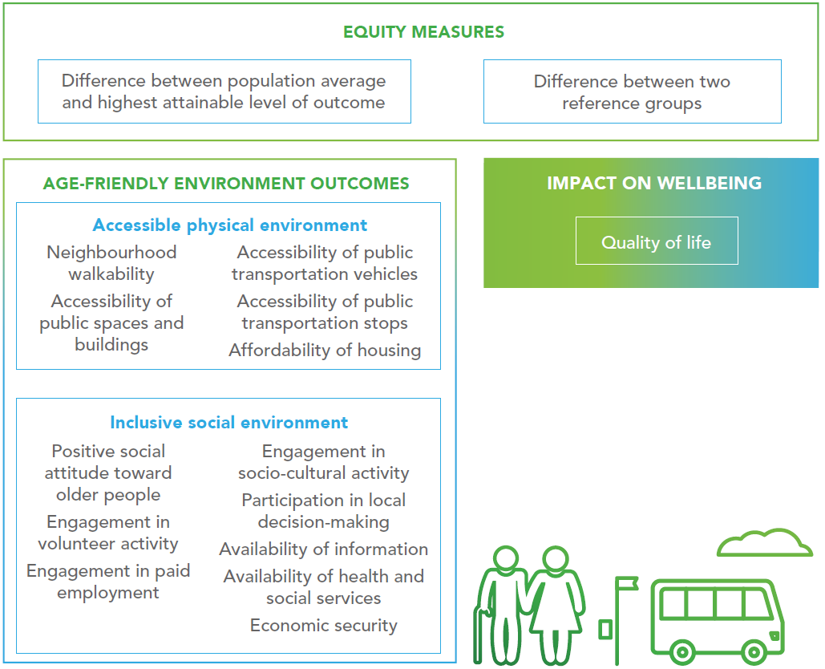
Age-friendly City Core Indicators
Notes:
So here are the core indicators of Age-friendly Cities. You can see that in addition to the indicators of the environment and the impact on wellbeing, we made sure to include measures of equity, that is, the extent to which the age-friendliness benefits all people fairly. In the guide itself, we go a step further to suggest specifications of how to measure each indicator, while at the same time emphasizing that the user should be feel encouraged to adapt the indicator specifications to their local context, especially if global comparability is not their primary concern.

Slide 12
Key issues for development process
Build on existing resources
Consider scientific evidence
Consider practical utility and feasibility
Mostly relying on a top-down approach but incorporating some bottom-up feedback
Notes:
In developing the core indicators, we wanted to make sure we built upon existing resources and past efforts – so as not to reinvent the wheel; we wanted to use an evidence-based approach; we also wanted to make sure they would be practical and feasible. We relied mostly on a top-down approach to identify the indicators from the literature and through expert consultations, while also incorporating some aspects of bottom-up feedback.

Slide 13
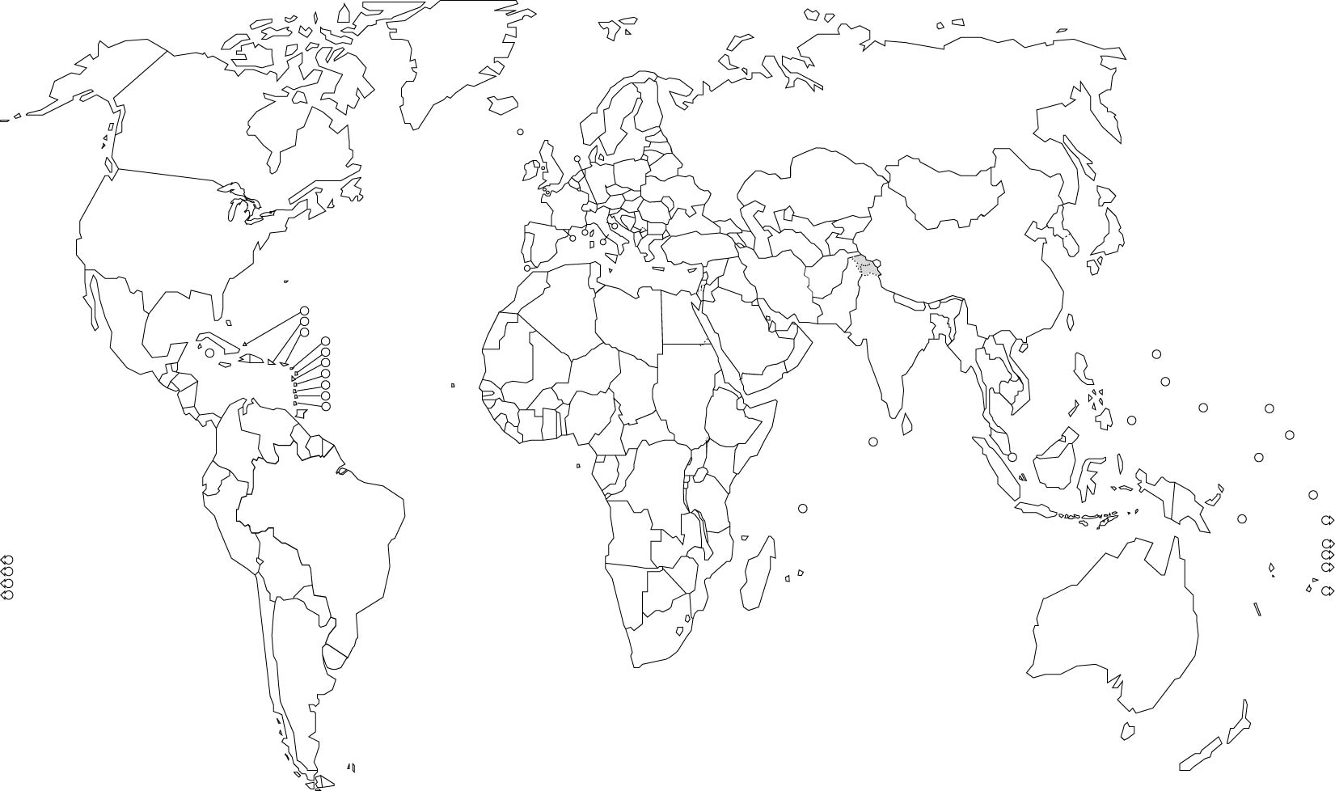
Global landscape review of relevant indicator initiatives in 2012
Canada Mortgage and Housing Corporation
Report on state of public health in Canada: CPHO
WHO European Healthy Cities Subnetwork on Healthy Aging
Aging and disability: CCDS
Mainstreaming Aging: Indicators to monitor implementation
WHO SAGE-INDEPTH
Older Americans Report: USA
Health indicators in NORC: NYC
JAGES HEART
HRS: Growing older in America
World Population Aging: UNDESA
Aging in the Arab countries: UNESCWA
Demographic prognosis for South Asia: UNFPA
Population aging in the Caribbean: UNECLAC
WHO MDS on Aging in Sub-Saharan Africa
Positive aging indicators: New Zealand
Notes:
Specifically, we started with a literature review and landscape analysis of existing indicator initiatives related to ageing, health and, to the extent possible, the urban environment, from around the world. At the time, in 2012, there were not many initiatives that specifically looked at Age-friendly Cities. Since then, there has been a surge of research on Age-friendly Cities and Communities which I wish we could have captured – but I guess you can say we were ahead of the curve! This initial review resulted in creating a pool of about 160 indicators.

Slide 14
Iterative consultations with experts and end users
Quebec, Canada, 2013
St Gallen, Switzerland, 2012
End-user survey, 2013
Notes:
We then refined and narrowed down the core indicators through an iterative process that began with an expert consultation, then a survey of potential end-users of the indicators (meaning local government officials) and another expert consultation after that.

Slide 15
Indicator prioritization criteria
Technical criteria
Measurable
Valid
Replicable
Sensitive to change
Possible to disaggregate
Practical criteria
Aligns with local goals
Can be linked to action
Within local influence
Easy to collect in a timely manner
Socially acceptable
Notes:
During this process of indicator prioritization we considered the following criteria. It was important for us to engage scientific experts who could offer their knowledge about the technical characteristics of the indicators, while it was equally important to understand the perspective of local government officials and community members who would eventually use the indicators to make sure we prioritized indicators that would be feasible to measure and also socially accepted.

Slide 16
Tensions and trade-offs
Universal
Conventional
Summation
Perception
Developed country context
Urban context
Contextual
Aspirational
Disaggregation
Objective measures
Developing country context
Rural context
Notes:
As we prioritized the indicators, we struggled with many tensions and trade-offs. Should we prioritize indicators that are more universal or those that are more contextual? Should we err on the side of selecting more conventional indicators which are routinely measured, or should we select more aspirational indicators for which no data may exist yet? This is when we had to revisit and reconfirm the underlying concept we were trying to measure and the intended purpose and focus of the core indicators.

Slide 17

Global pilot study of AFC core indicators
Fishguard & Goodwick
4,869
Tuymazy
132,000
New Haven
130,000
Bowdoinham
2,889
Udine
100,541
Bilbao
347,778
Tehran (District 2)
632,917
Shanghai (Jing’an District)
296,100
Washington DC
658,893
Dijon
151,672
Hong Kong
7,234,800
New Delhi (NDMC)
249,998
Nairobi (Korogocho & Viwandani)
3,138,869
GNAFCC:
La Plata City
654,324
Banyule
124,475
Member
Non-Member
Notes:
As a final step to ensure that the core indicators would have practical utility, we conducted a global pilot study in which we had 15 sites across the globe do a trial assessment of the core indicators. We purposefully selected a very diverse set of pilot sites – urban, rural, small, large, members of the Global Network or not, in various parts of the world. Hopefully you can relate to one or more of the pilot sites in one way or another. Due to time constraints, I cannot go into detail about how each of these pilot sites measured the indicators and what their experiences were like, but several examples of the indicator measurements performed by these pilot sites are included in the Annex of the indicator guide.

Slide 18
Indicator specifications
Accessibility of public transportation vehicles
Engagement in volunteer activity
Proportion of public transport vehicles with designated places for older people or people who have disabilities
Proportion of older people who report that public transport vehicles are physically accessible for all people, including those who have limitations in mobility, vision or hearing.
Proportion of older people in local volunteer registries.
Proportion of older people who report engaging in volunteer activity in the last month on at least one occasion.
Notes:
In each pilot site, we asked that they make their best attempt to measure all core indicators, as well as some supplementary indicators. The guide suggests two possible ways of measuring each indicator – one that relies on administrative data, which often focus on objective characteristics of the environment, and the other that relies on surveys of older citizens that reveal perceptions.
[READ SLIDE]
Pilot sites were asked to measure the indicators using one or both of the definitions provided in the guide, or by adapting the definitions to the local context as appropriate, and using whatever data sources they had. They were encouraged to utilize existing data considering the time constraints and also to not create a major burden on them, but in many cases, surveys were actually carried out.

Slide 19
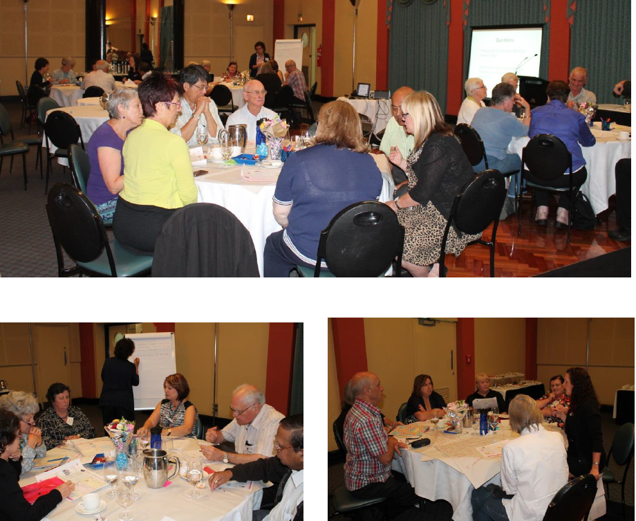
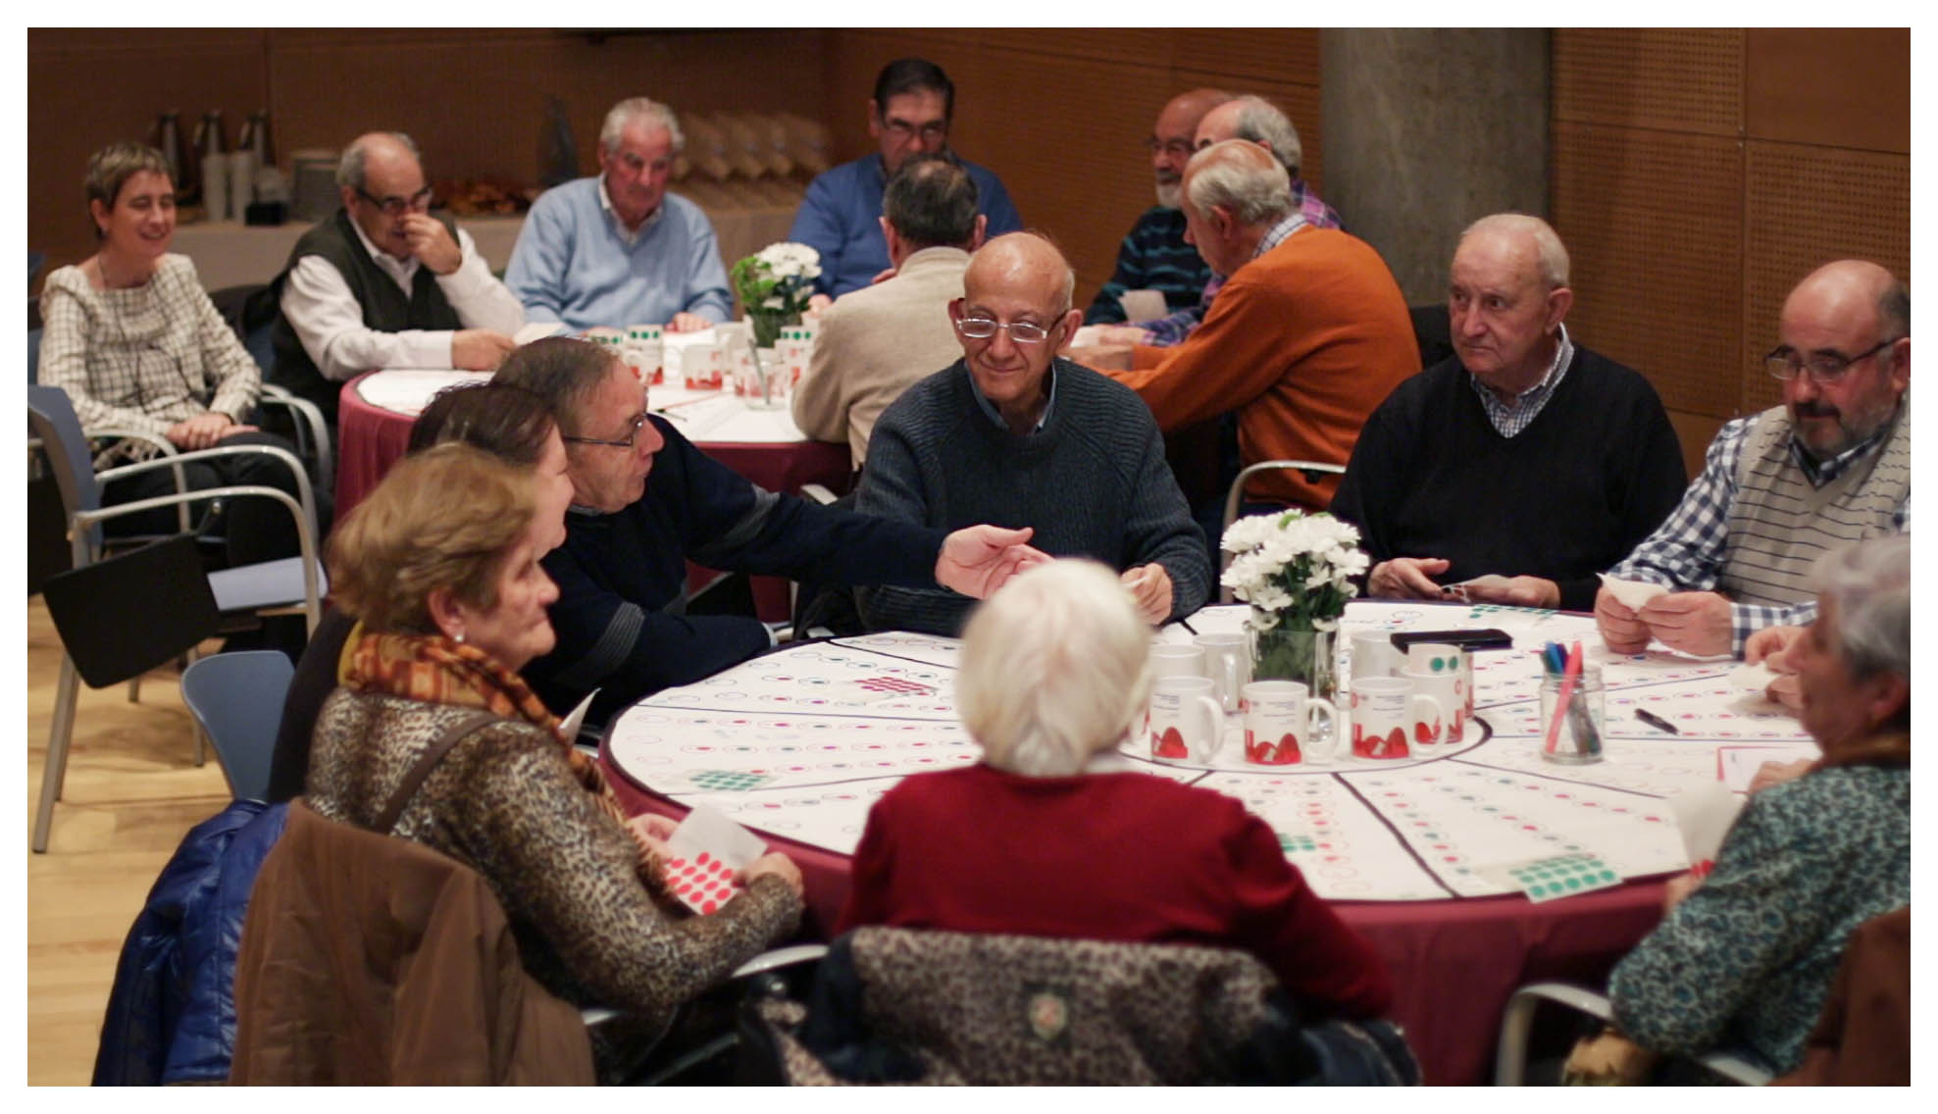
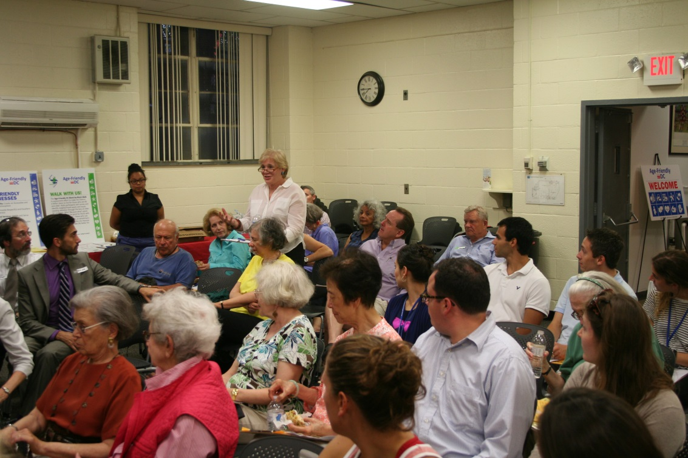
Notes:
We were very pleased to see that in most if not all pilot sites, community members, including older adults, were engaged to discuss the relevance of the indicators in their local context as well as to make sense of the indicator assessment results. In this way we were able to incorporate some bottom-up feedback into our indicator selection, and more importantly, the pilot site teams were able to create a sense of ownership of the indicators among its community members.

Slide 20
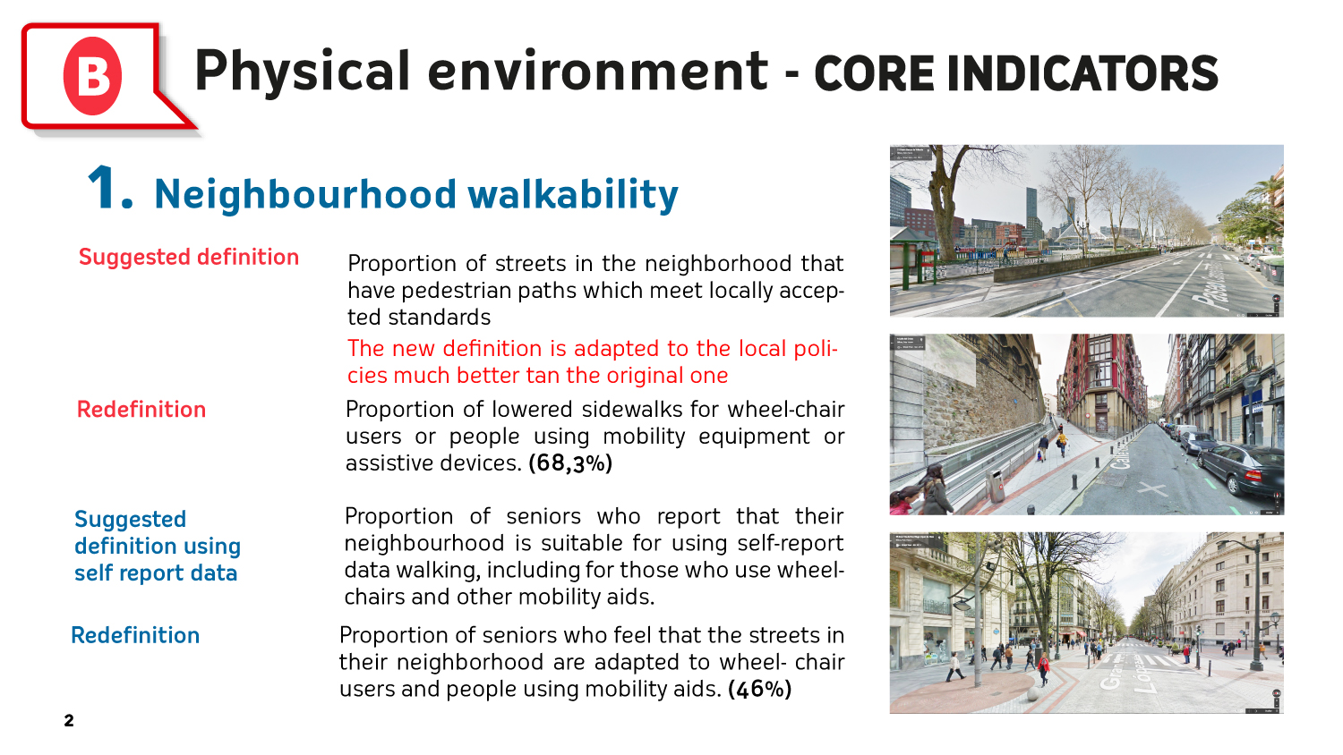
Notes:
The pilot test also revealed the typical tension or inconsistency between objective characteristics of the environment reported by governments and perceptions of the environment reported by residents. This example here shows the case of measures of neighbourhood walkability in Bilbao, Spain.
[READ THE SLIDE]
This underscored the important issue of data validation or triangulation, and the different but equally valuable information offered by objective measures and perceived measures.

Slide 21
Magnitude of equity gap in the city
(New Haven, USA)
Social participation: volunteer activity
Inequality Ratio = 1.00
--> Equality
DATAHAVEN
Data for Community Action
Notes:
We were also very pleased to find that the concept of equity, or equality in statistical terms, was very much valued and appreciated by the pilot sites despite it being an abstract construct. Shown here is an example of how in one of the pilot sites, New Haven, USA, they measured the inequality in social participation of older people, as measured by their volunteer activity, using level of income as the stratification variable. The results showed there was a 14 percentage point difference between the participation rates among older people with an annual income of USD 30,000 or greater, and among those with less than USD 30,000. The participation rate was higher among those with a higher level of income. Based on these results, they were able to substantiate the gap that needs to be closed through age-friendly interventions.
Some of the other factors that were commonly examined for equity included gender, education and geographic area, like districts/neighbourhoods. While many of the pilot sites were limited in their capacity to actually calculate the measures of equity, they all expressed a strong desire to assess equity because of its value to society. You can find these and many more examples from the pilot sites in the Annex of the indicator guide.

Slide 22
A Positive Experience for Pilot Sites
Helped identify priorities/gaps
Facilitated an evidence-based approach
Data used as a driver for change
Helped promote the work locally and nationally
Increased awareness and reinforced collaborative relationships
Provided validity and status to the team’s work
Notes:
Overall, the pilot sites expressed that the evaluation exercise was a very positive experience with many benefits. [READ SLIDE]

Slide 23

Sustainability
Tie into existing structures
Build and maintain partner engagement
Anticipate government turnovers
Example: Age-friendly DC
  Integration into Livability Survey
  Annual progress reports
  Evaluation of First Strategic Plan
  Baseline for next Strategic Plan
Notes:
The pilot study was a one-time effort, but it’s important for the communities to sustain their regular monitoring and evaluation activities. The key to sustainability are to tie the M&E into existing structures, both in terms of collecting data as well as reporting and using the data. Partnership engagement is also key to sustainability, especially to survive government turnovers. Political champions are important, but their engagement may only last as long as they are in office, so other more sustainable partnerships with community-based organizations will be essential.
Age-friendly DC, in Washington DC, USA, provides a good example of how to ensure sustainability of an Age-friendly initiative, including indicator assessments. As a result of the pilot study, they identified several existing data sources in the community that include the relevant indicators; they have also integrated the WHO core indicators into their Livability Survey. Annual progress reports and Mayor’s achievement reports include the reports on the indicators. The indicators are also used to measure progress and outcomes of the first Age-friendly DC Strategic Plan for 2012-2016, and will serve as the baseline for the next Strategic Plan for 2018-2022.

Slide 24
How can you use the indicator guide?
To inform the initial selection of indicators
To refine existing indicators
To enhance comparability of indicators
To learn from and be inspired by the experience of the pilot sites
To identify areas in need of more research
To advocate the need for better data and action
To build a stronger evidence base for promoting age-friendly environments!
Notes:
In conclusion, I’d like to summarize some of the ways in which the AFC core indicator guide can be useful to you.
[READ SLIDE]
Importantly, I do want to acknowledge that there are other Age-friendly City evaluation guides and tools that now exist, and that the WHO guide is not intended to supersede them. We hope that the guide can be used as a complement to other existing tools and resources to help you in your work. And together, it is our hope that we can build a stronger evidence base for promoting age-friendly environments.

Slide 25

WHO Centre for Health Development
(WHO Kobe Centre)
Webpage
www.who.int/kobe_centre
E-mail
kanom@who.int
Twitter
@WHOKobe
Thank you!

